Slide 1
Evaluating predictive models in legal judgement classification: a signal detection theory approach
Poznań, 20.06.2025
SICSS-AMU/Law

Slide 2

Introduction
This study explores the use of Signal Detection Theory (SDT) as a framework for assessing the performance of predictive models in legal judgment classification.
SDT provides a nuanced understanding of model behavior by distinguishing between sensitivity to true signals and the tendency to produce false alarms.
Notes:
Ugne

Slide 3
What this Data Says About
This project looks at how well different models can predict legal judgement outcomes, such as whether a case results in a human rights violation or not. Using real case data, we compare model predictions with actual court decisions.
The data includes both the true outcomes and predictions from several models. By applying ideas from signal detection theory, we aim to better understand how accurate and reliable these models are in identifying violations, and how often they make mistakes like false alarms or missed violations.
Notes:
Ugne

Slide 4
III
Legal perspective
📜 Each case = real human rights complaint (ECtHR)
🚨 False negatives = risk of overlooking violations
⚖️ Model bias affects justice (liberal vs. conservative trade-off)
🧠 SDT helps measure not just accuracy, but legal risk
🔍 Relevant for AI in courts, legal triage & rights protection
Notes:
Kaja

Slide 5
IV
Data set – brief overview
The analysis is based on a dataset of decisions from the European Court of Human Rights (ECtHR).
The data includes textual, procedural, and prediction-related information for over 11,000 cases, each annotated with a binary outcome:
1 = Violation
0 = No violation
Notes:
Kaja

Slide 6
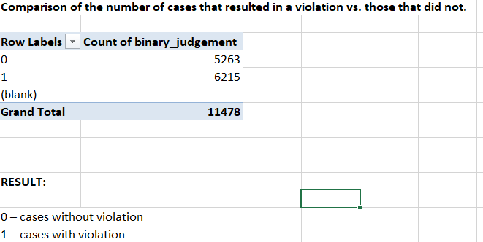
V
Notes:
Kaja

Slide 7
Signal detection matrix
VI
 |  | THERE WAS VIOLATION
 |  | YES (1) | NO (0)
DOES THE MODEL PREDICTED VIOLATION? | YES (1) | True Positive Correctly predicted a violation | False Positive Incorrectly predicted a violation
 | NO (0) | False Negative Incorrectly predicted no violation | True Negative Correctly predicted no violation
Notes:
Kaja

Slide 8

Used models:
VII
logistic prediction
tree prediction
bayes prediction
Predicts the probability of a binary outcome (yes/no)
Outputs a value between 0 and 1
Assumes linear relationships between features and outcome
Useful for interpretable, probabilistic classification
Makes decisions by asking a series of yes/no questions
Builds a tree-like structure with rules at each split
Can overfit if the tree is too deep
Calculates the probability for each possible class and selects the one with the highest probability.
Assumes that all the features are independent of one another (naive but effective)
Works well with many features, even with small datasets
Fast, simple, and surprisingly accurate
Fun Fact: We also included a model called “attorney_prediction”, which always predicts “violation” (1).
Why? Because when a client walks into a lawyer’s office — there’s no such thing as a case you can’t win!

Slide 9
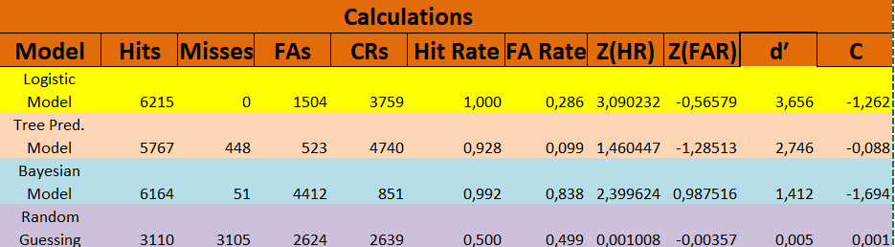
Outcomes for each model
VIII

Slide 10
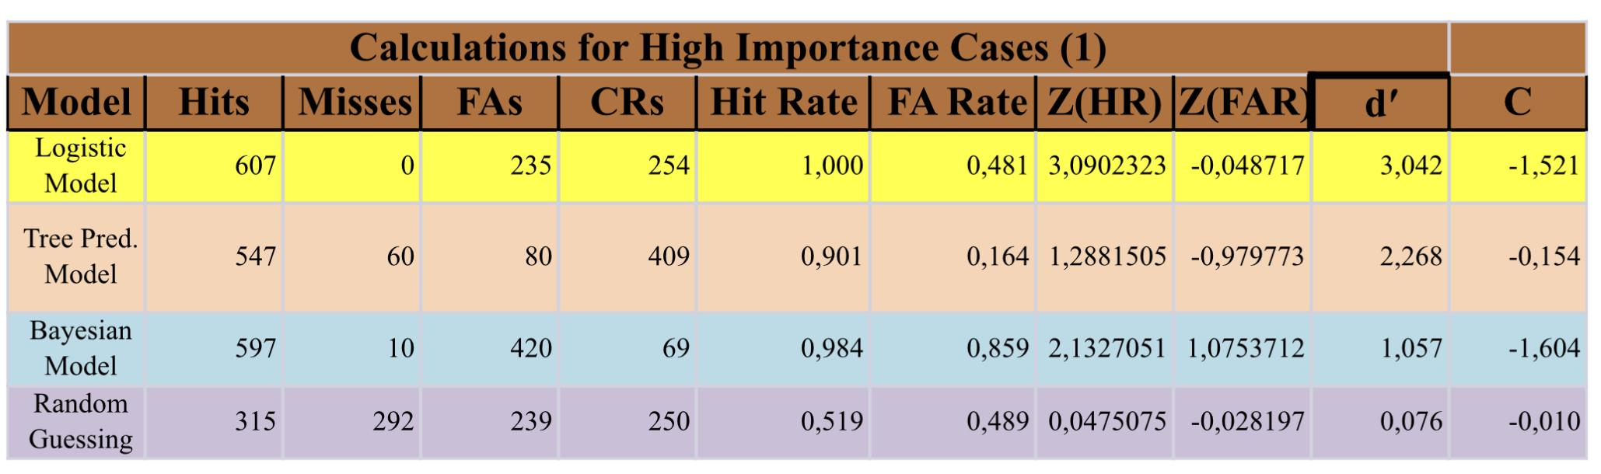
Outcomes for High Importance Case
IX

Slide 11
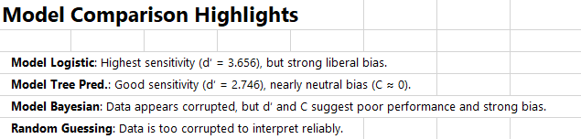
X

Slide 12
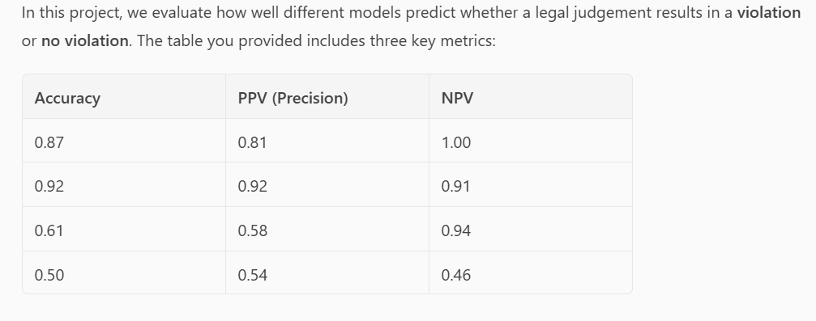
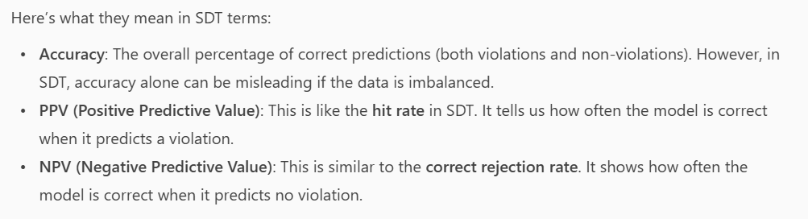
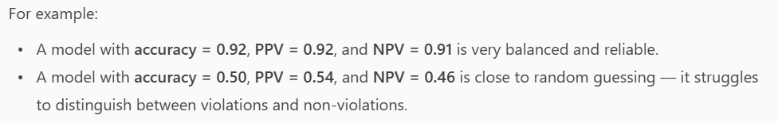
Accuracy
XI
I

Slide 13
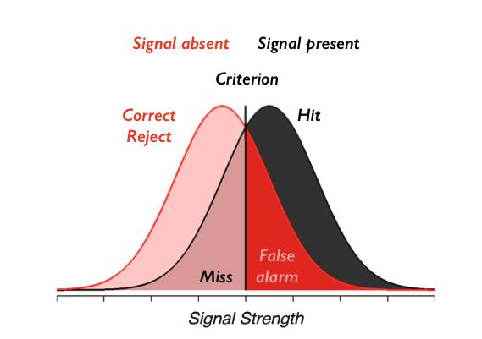
Visualisation
XII

Slide 14
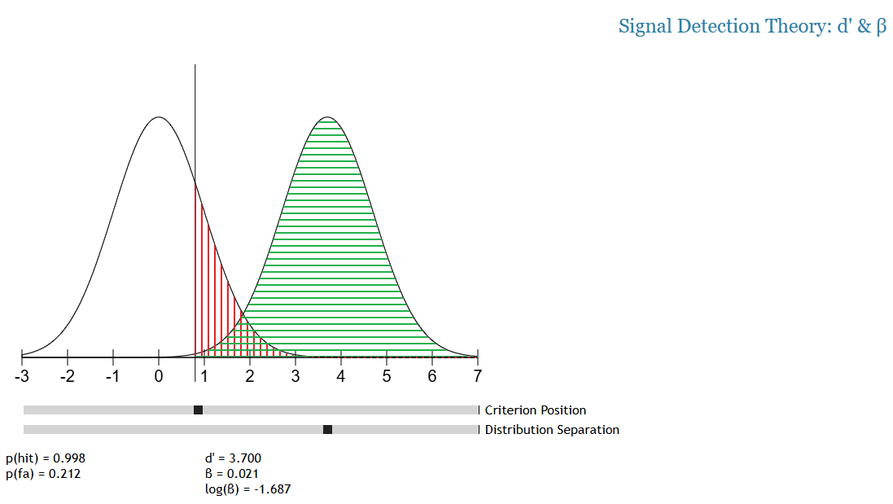
Logistics Model
XIII
Notes:
Logistics - lots of hits and correct rejections, no misses and relatively lots of false alarms. Liberal model.

Slide 15
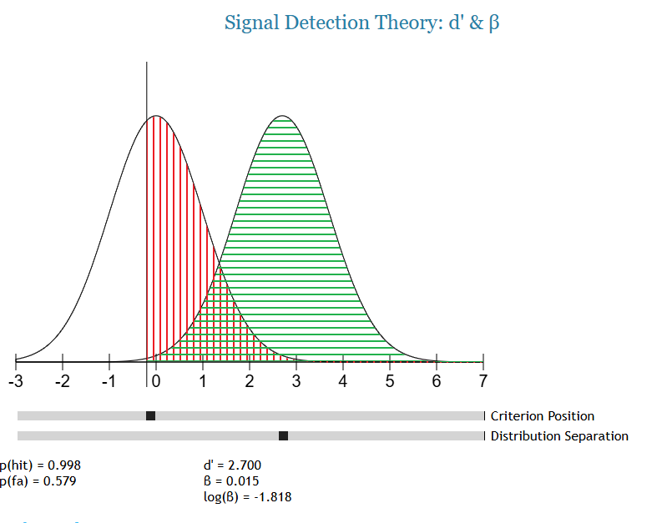
Tree Prediction Model
XIV
Notes:
Tree prediction - number of hits slightly lower than logistics. It performed better at spotting correct rejections and avoided false alarms. Conservative.

Slide 16
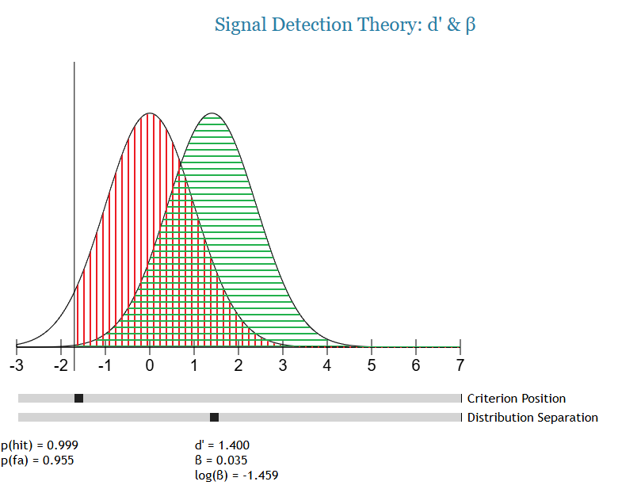
Bayesian Model
XV
Notes:
Bayesian model - absurd amount of false alarms. Although hit rate similar to logistics model. Unfortunately, not many correct rejections. Very liberal.

Slide 17
What we learned?
XVI
🔍 Signal Detection Theory (SDT) adds depth
Goes beyond traditional accuracy by distinguishing between sensitivity (true positives) and specificity (false alarms).
Provides a more interpretable framework for evaluating legal AI models.
⚖️ Legal context matters
False negatives (missed violations) carry serious ethical and human rights implications.
Evaluations must consider the real-world impact of model decisions in judicial settings.
📈 Model performance varies
No single model performs perfectly across all cases, especially high-importance ones.
The “attorney_prediction” model highlights a bias toward overprediction — useful for comparison but not practical.
🧠 Implications for AI in justice
SDT helps identify where AI models may mislead or reinforce bias.
Offers tools for building more transparent and accountable AI for legal triage and decision support.
Notes:
🧠 “To wrap up, our main takeaway is that Signal Detection Theory gives us a deeper, more meaningful way to evaluate legal AI. Instead of just looking at accuracy, SDT helps us understand how models balance catching true violations versus making false alarms.”
⚖️ “This is especially important in legal contexts, where missing a real human rights violation—a false negative—can have serious consequences. So, we need to think not just about how well a model performs overall, but how it performs in high-stakes situations.”
📊 “We found that different models behave differently—some are more liberal, others more conservative.”
🔍 “In the future, these insights can help courts and legal professionals make smarter use of AI—by adjusting thresholds, measuring risk better, and using these tools to support, not replace, human judgment.”

Slide 18

XIII
Thank you!
Team:
Ugne Kundrotiene, Aleksandra Kowalik, Kaja Heckert, Monika Stanisławska, Audrey Nury, Michalina Marcia
Team guide: Mikołaj Wieczór
Poznań, 20.06.2025
SICSS-AMU/Law

